Slide 1
The NIST Cybersecurity Framework 2.0 Initial Public Draft
Troy Stoneking
Technical Trainer/Cybersecurity Assessor
Levi, Ray & Shoup Inc.
Webinar begins at 11:00 am US Central time

Slide 2
Session Overview
Major changes from the NIST Cybersecurity Framework version 1.1 to the 2.0 Initial Public Draft (IPD)
Goals of the NIST CSF 2.0 IPD
Changes to the Framework Core
The Value of Implementation Examples
Updated Methodology for Informative References
Changes in Using the Framework
Free Resources/Questions and Answers

Slide 3
Major Changes in the NIST CSF 2.0 IPD
New Name
Expanded Scope
New References
Improved Implementation Guidance
New Emphases for a Changing Landscape

Slide 4
New Name
Previous: Framework for Improving Critical Infrastructure Cybersecurity
New: Cybersecurity Framework
The Framework is: “guidance to help [organizations] to understand, assess, prioritize, and communicate about cybersecurity risks and the actions that will reduce those risks.”

Slide 5
Expanded Scope
Updated to reflect use by all organizations
Modified focus on organizations not just in the US, but around the world

Slide 6
New References
Cybersecurity Supply Chain Risk Management Practices for Systems and Organizations (SP 800-161r1)
NIST Privacy Framework
NICE Workforce Framework for Cybersecurity (SP 800-181)
Secure Software Development Framework (SP 800-218)
Performance Measurement Guide for Information Security (SP 800-55)
Integrating Cybersecurity and Enterprise Risk Management (NIST IR 8286) series
Artificial Intelligence Risk Management Framework (AI 100-1)

Slide 7
New References (cont.)
No longer limited to six references
Upcoming online tool on the NIST CSF website
Includes CSF 2.0 Core with human- and machine-readable formats
Will allow organizations to see the relationships between the Core and updatable Informative References

Slide 8
Improved Implementation Guidance
Implementation Examples added
Framework Profiles guidance revised significantly and expanded
Notional templates included

Slide 9
New Emphases for a Changing Landscape
Emphasize cybersecurity governance
Emphasize cybersecurity supply chain risk management
Clarify understanding of cybersecurity measurement and assessment

Slide 10
Goals of the NIST CSF 2.0 IPD
Describe essential cybersecurity outcomes that can help an organization reduce its cybersecurity risk
Understand and Assess
Prioritize
Communicate

Slide 11
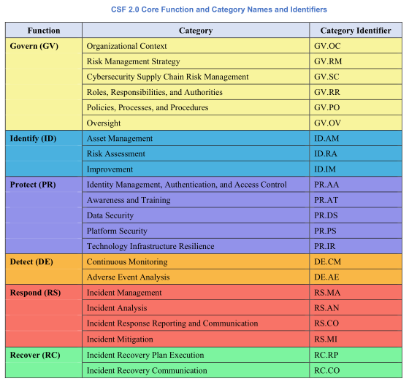
Changes to the Framework Core
6 Functions
22 Categories
106 Subcategories
Formerly 5, 23, 108

Slide 12
Changes to the Framework Core
Addition of the Govern (GV) Function
The Addition and Value of Implementation Examples
Updated Methodology for Informative References

Slide 13
Addition of the Govern (GV) Function
Cross-cutting
How an organization achieves and prioritizes the outcomes of the other five Functions in the context of mission and stakeholder expectations
Critical for incorporating cybersecurity into enterprise risk management strategy
Oversight of cybersecurity strategy

Slide 14
The Addition and Value of Implementation Examples
Part of the Core
Concise, action-oriented steps to help achieve the outcomes of the Subcategories
Not a comprehensive list
Do not represent a baseline of required actions
Maintained online

Slide 15
Updated Methodology for Informative References
Part of the Core
Will be maintained online (not live yet)
More frequent updates

Slide 16
Changes in Using the Framework
Previous guidance: Seven-Step Process
Updated flexibility and customizability
Based on organization’s unique mission and risks
With an understanding of stakeholder expectations, risk appetite and tolerance, organizations prioritize cybersecurity activities, enabling informed decisions about cybersecurity expenditures and actions

Slide 17
Changes in Using the Framework
Potential ways to use the Framework:
Create and use Framework Profiles
Assess the organization’s achievement of cybersecurity outcomes
Characterize cybersecurity risk management outcomes with Framework Tiers
Improve cybersecurity communication with internal and external stakeholders

Slide 18
Q and A
Free Resources
Questions and Answers

Slide 19
The NIST Cybersecurity Framework 2.0 Initial Public Draft
GetSmart@LRS.com
Troy Stoneking
Technical Trainer/Cybersecurity Assessor
Levi, Ray & Shoup Inc.

